Slide 1
Members Seminar
28th July 2021

Slide 2
Context and Overview
Autumn 2020 – All councils in North Yorkshire, Somerset and Cumbria were invited to submit locally led proposals for unitary local government
Spring 2021 – Public consultation on proposals
21 July 2021 – Secretary of State announced which proposals, subject to Parliamentary approval, will be implemented:
  North Yorkshire – single county unitary council
  Somerset – single county unitary council
  Cumbria – two unitary councils (East and West)
Elections to new councils 5 May 2022
Vesting day 1 April 2023

Slide 3
MHCLG - Ministerial Statement to Parliament
Criteria for a proposal to be implemented:
    Improve local government and service delivery across its area;
    Commands a good deal of local support;
    Any unitary councils to be established have a credible geography.
  MHCLG consulted on both North Yorkshire proposals – 4,200 responses including:
    Support from 5 local MPs for NYCC’s proposal
    A body of support for this proposal amongst residents
    Evidence of significant support from businesses, including the Y&NY Chamber of Commerce
    Wide support from public sector providers including Health organisations, the University of York, Chief Fire Officer and Chief Constable of the North Yorkshire Police.

Slide 4
MHCLG - Ministerial Statement to Parliament
  “For North Yorkshire I have decided to implement, subject to Parliamentary approval, the proposal for a single unitary council for the whole of the existing administrative county of North Yorkshire. I considered that this proposal strongly met all three of the criteria”.
  The geography of the new council will:
    have the critical mass to deliver all services effectively at a local level to a large rural area whilst preserving delivery of current county services
    maintain the brand of North Yorkshire and established local identity
    maintain a geography which aligns with existing public sector partnerships without disruption.
  “I have also decided not to implement the proposal for two unitary councils………I considered that this proposal did not meet the improving local government and service delivery and credible geography criteria”.

Slide 5
Consultation Responses NY - Summary
0% East / West

Slide 6
Consultation Responses NY - Summary
No data for East/West

Slide 7
Consultation Responses NY - Summary
No data for East/West
No data for East/West
No data for East/West

Slide 8
Summary of comments
MHCLG Feedback:
“Strongly meets all three criteria”
“A good deal of local support in the round for a single unitary”
“Significant support from businesses, including the Y&NY Chamber of Commerce”
Significant support from public sector service providers
Will “preserve delivery of current county services”
“It maintains the brand of North Yorkshire”
“Aligns with arrangements in existing public sector partnerships”
Partner Feedback:
Education - positive impact of single unitary - continuity of existing partnership arrangements.
Police - work well with the county council - disbanding of current arrangements could be detrimental to the effective delivery of policing services during any transition period.
Health - Single unitary has a positive impact. NHS works in close partnership with NYCC. “This has created opportunities to develop a more integrated health and care offer for citizens”.

Slide 9

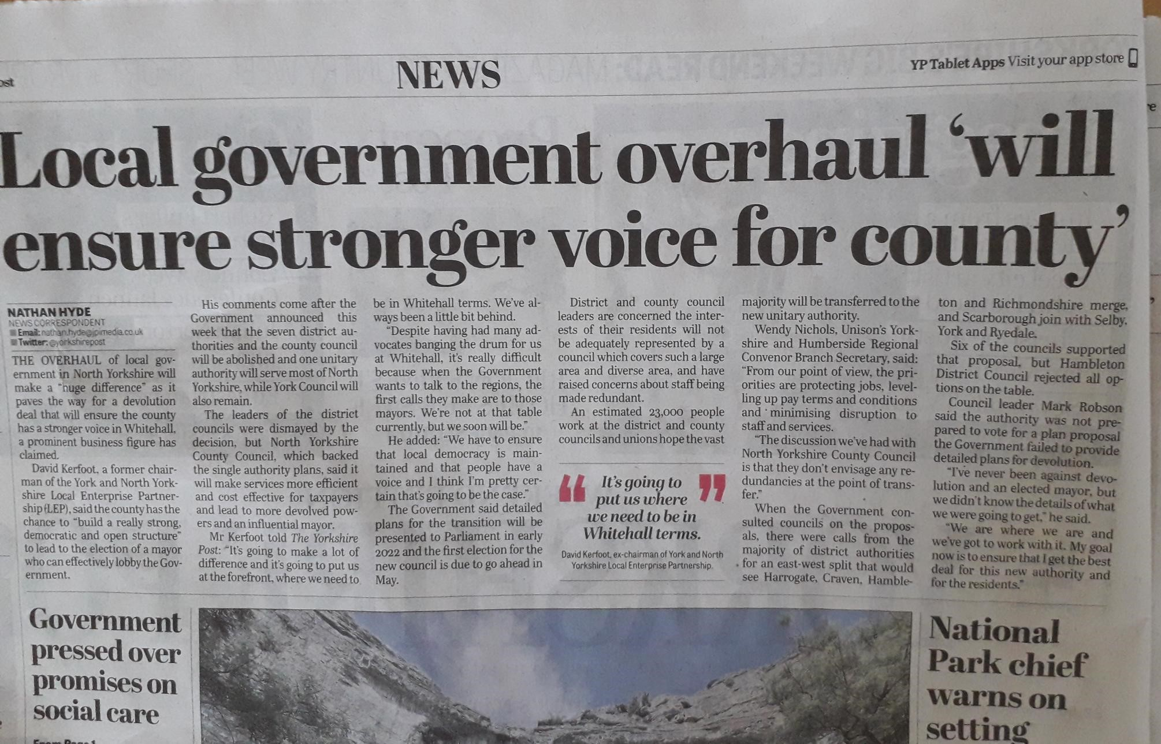
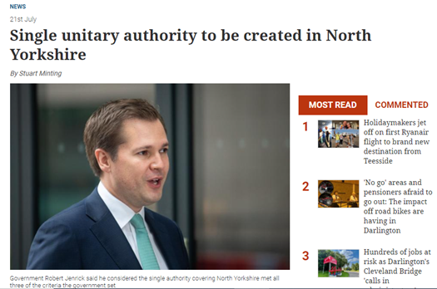

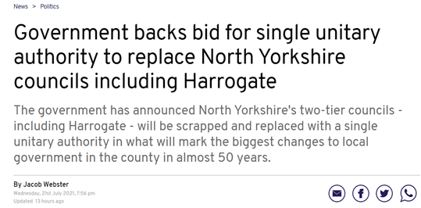
Media response

Slide 10
LGR decision in Somerset & Cumbria
Subject to Parliamentary approval:
Cumbria –
  two unitary councils –
  An East unitary council covering the existing areas of Barrow, Eden and South Lakeland
  a West unitary council covering the existing areas of Allerdale, Carlisle and Copeland.
Somerset –
  a single unitary council for the whole of the existing administrative county of Somerset.

Slide 11
Next Steps in North Yorkshire
Ministers now expect all the councils in North Yorkshire to work collaboratively and constructively to implement the single council for North Yorkshire proposal.
NYCC as proposer of the proposal will have a particular role but will be expected to work closely with District Councils.
Initial engagement with District Council colleagues has started.
Expected that first MHCLG meeting with County and Districts Chief Executives to take place in mid-August.
Moving forward and building on the strengths that we have across Districts and County.

Slide 12
Single Unitary Proposal – Key Elements
Reduce duplication, bring services together and make savings
Improve efficiency and effectiveness of local government services
A local office in every District area
A range of local customer access points (approx. 30)
A council of around 90 members
6 Local Area Committees
Community Network arrangements for every market town
New ways of working with and empowering Town and Parish Councils

Slide 13
Stages – detail
Decision Made (Jul 21) – immediate communications
Decision to SCO (Jul 21 – Jan/Feb 22) – informal stage, working with Districts, negotiate final SCO and final wards for unitary elections
SCO to Elections (Feb 22 – May 22) – formal structures in place – Implementation Executive and Implementation Team, prepare elections, put in arrangements to run the County Council for a year and implement the changes for April 23
Elections to Vesting Day (May 22 – Apr 23) – new council members elected and Executive in place, new constitution, recruitment of top tier officers, transition to new council, locality arrangements
Year 1 and beyond (Apr 23 onwards) – further transition & transformation, Boundary Commission review

Slide 14
Immediate Tasks to Start Transition Work
County & Districts will need to work together
Define governance arrangements
Agree transition plan
Establish Work Streams
Put in place resources to manage the transition
    Next Q report to put in place budget to fund unitary transition work

Slide 15
Areas to be covered by Work Streams
To be agreed via the governance arrangements, including both County and District
Democracy & Legal Finance People Emergency Planning Digital, Data and Technology Property, Contracts and Commercial Locality Working Communications, Engagement and Branding Policy and Performance Framework | Service Continuity Housing Planning Licencing and Standards Economic Development (incl. Culture and Tourism) Revs and Bens Waste and Environment Street Scene and Parking Leisure

Slide 16
Delivering New Localism – Key Work Stream
Local Accountability - Area Committees
6 area committees, political accountability for the discharge of statutory functions and services at local level
Empowerment of Town and Parish Councils
Devolution of powers to community groups and parish and town councils to run assets and services where they want to
Local Action through Community Networks
Local people, partners and communities coming together in about 25 community networks to identify and deliver against local priorities
Working Group of Councillors
Working group of Town and Parish Councils
YLCA on board with expressions of interest from over 50 Town and Parish Councils

Slide 17
Targets for Vesting Day
Key ‘must dos’…
Ensure safe and legal operations
Democratic arrangements in place
Transfer of staff
Transfer of property, assets and contracts
IT systems and technology in place
Customer access / One Front Door (and simplification of customer journey)
Locality transformation

Slide 18
Structural Change Order
Creates the new unitary authority from 1st April 2023
Sets out the timing of elections : 5th May 2022
Specifies Wards and number of Councillors
Imposes Legal duties on the authorities:
  Duty of Councils to cooperate and consult with each other
  Work together to prepare for the transfer of the functions, property, rights and liabilities to the new unitary authority
  Duty to provide information as reasonably requested

Slide 19
Structural Change Order
The governance of the transitional arrangements:
  First transitional Period: Date of Order until Elections (Jan/Feb – May 2022)
  Implementation Executive: Member political oversight:
    Consist of representatives from County Council and District Councils
    Responsibility for the discharge of transitional functions will solely be responsibility of IE
    Duty is to prepare, revise and Review the Implementation Plan to provide for the transition and have regard to the proposal.
    Can require the County and District Councils to take such action that is necessary to facilitate the transition
    Will not have responsibility for service delivery – only the transition

Slide 20
Structural Changes Order
  Second transitional Period: Elections to vesting date (May 2022 – April 2023)
  Executive of newly elected members: Member political oversight:
    Consist of representatives from the newly elected Councillors
    Responsibility for the discharge of transitional functions will transfer to the new Executive
  Officer Implementation Team
    Under First and Second Transitional Period, the members will form a team of officers known as the Implementation team to assist the IE and Executive in managing the transition.
    The Implementation Team will consist of officers from the County and the Districts
    Councils will have a duty to release officers from normal duties as required
  Chief Executive and Senior Team for new Council started to be appointed from Sept 2022

Slide 21
What does this mean for members?
You will remain as County Councillors until Elections in May 2022.
For those of you who are re-elected in May 2022 – you will continue as a County Council until April 2023 and then serve as a unitary Councillor for 4 years.
For those of you who are district Councillors, you will remain on the District Council until April 2023 and then functions transfer to new unitary council.
Throughout the process there will be regular communications and reporting to Members

Slide 22
Elections
Estimated Provisional Timetable:
Publication of Notice of Election Not later than 28th March 2022
Delivery of nomination papers 5th April 2022
Polling Day 5th May 2022
Expect it will be a five year term with elections every 4 years thereafter in May 2027 but for the SCO to determine
Parish Council elections: SCO will consider resetting them to be on the same cycle as the unitary authority.

Slide 23
Ward Boundary Changes
The Structural Changes Order will set out the wards for the new council
Our proposal envisaged about 90 Councillors
Other options are 72 or 144 Councillors, using existing county divisions
If there are about 90 Councillors, new wards will have to be created by joining together existing electoral units, for example existing district council wards
New wards would be determined by MHCLG (with advice from LGBCE). A full Electoral Review by LGBCE will take place within the first term of the new Council

Slide 24
Supporting Staff through Change
Strong and frequent communication
    Intranet material – news & more in depth support
    Promoting key messages via other staff channels – email, Yammer, Key Messages
    FAQs
    Chief Executive regular webinars
    Manager Support Packs
Work with District colleagues to reassure District staff on opportunities and job security
Close engagement with Unison
Pursue Continuing Authority model to reduce TUPE impact on staff
Staff Support Networks / Staff Advice Service

Slide 25
Timeline
Day 0
Day 1
PHASES | Before Decision |  |  | Decision | Decision to SCO |  |  |  |  |  |  | SCO to Elections |  |  | Elections to Vesting Day |  |  |  |  |  |  |  |  |  | Year 1
 | 2021 |  |  |  |  |  |  |  |  | 2022 |  |  |  |  |  |  |  |  |  |  |  | 2023
 | May | Jun |  | Jul | Aug | Sept | Oct | Nov | Dec | Jan | Feb | Mar | Apr | May | Jun | Jul | Aug | Sept | Oct | Nov | Dec | Jan | Feb | Mar | Apr | May
Key Gov. Milestones |  |  |  | Decision |  |  |  |  |  | Structural Changes Order |  |  |  | Elections to new council |  |  |  |  |  |  |  |  |  |  | Vesting Day
Political Arrangements | County Councillors
 | District Councillors
 |  |  |  |  |  |  |  |  |  |  | Implementation Executive (made up of both CC/DC) |  |  | Newly elected Councillors (continuing Authority) |  |  |  |  |  |  |  |  |  |  | New Council

Slide 26
Devolution
One of the original drivers for unitarisation
PM speech about the importance of Devolution opportunities for County areas
Meetings needed with civil servants to understand how this can be taken forward
Timetable - TBC

Slide 27
Summary
Important moment for Local Government in North Yorkshire
Need to engage positively and bring together Local Government family
Partners and other stakeholders will want to engage to help shape new council
Need to put in place strong functional arrangements to deliver the change
Crucial to keep staff on board from all councils
Focus on key essentials for Day 1
Strong communication with all including Councillors

Slide 28
Questions?

