Slide 1
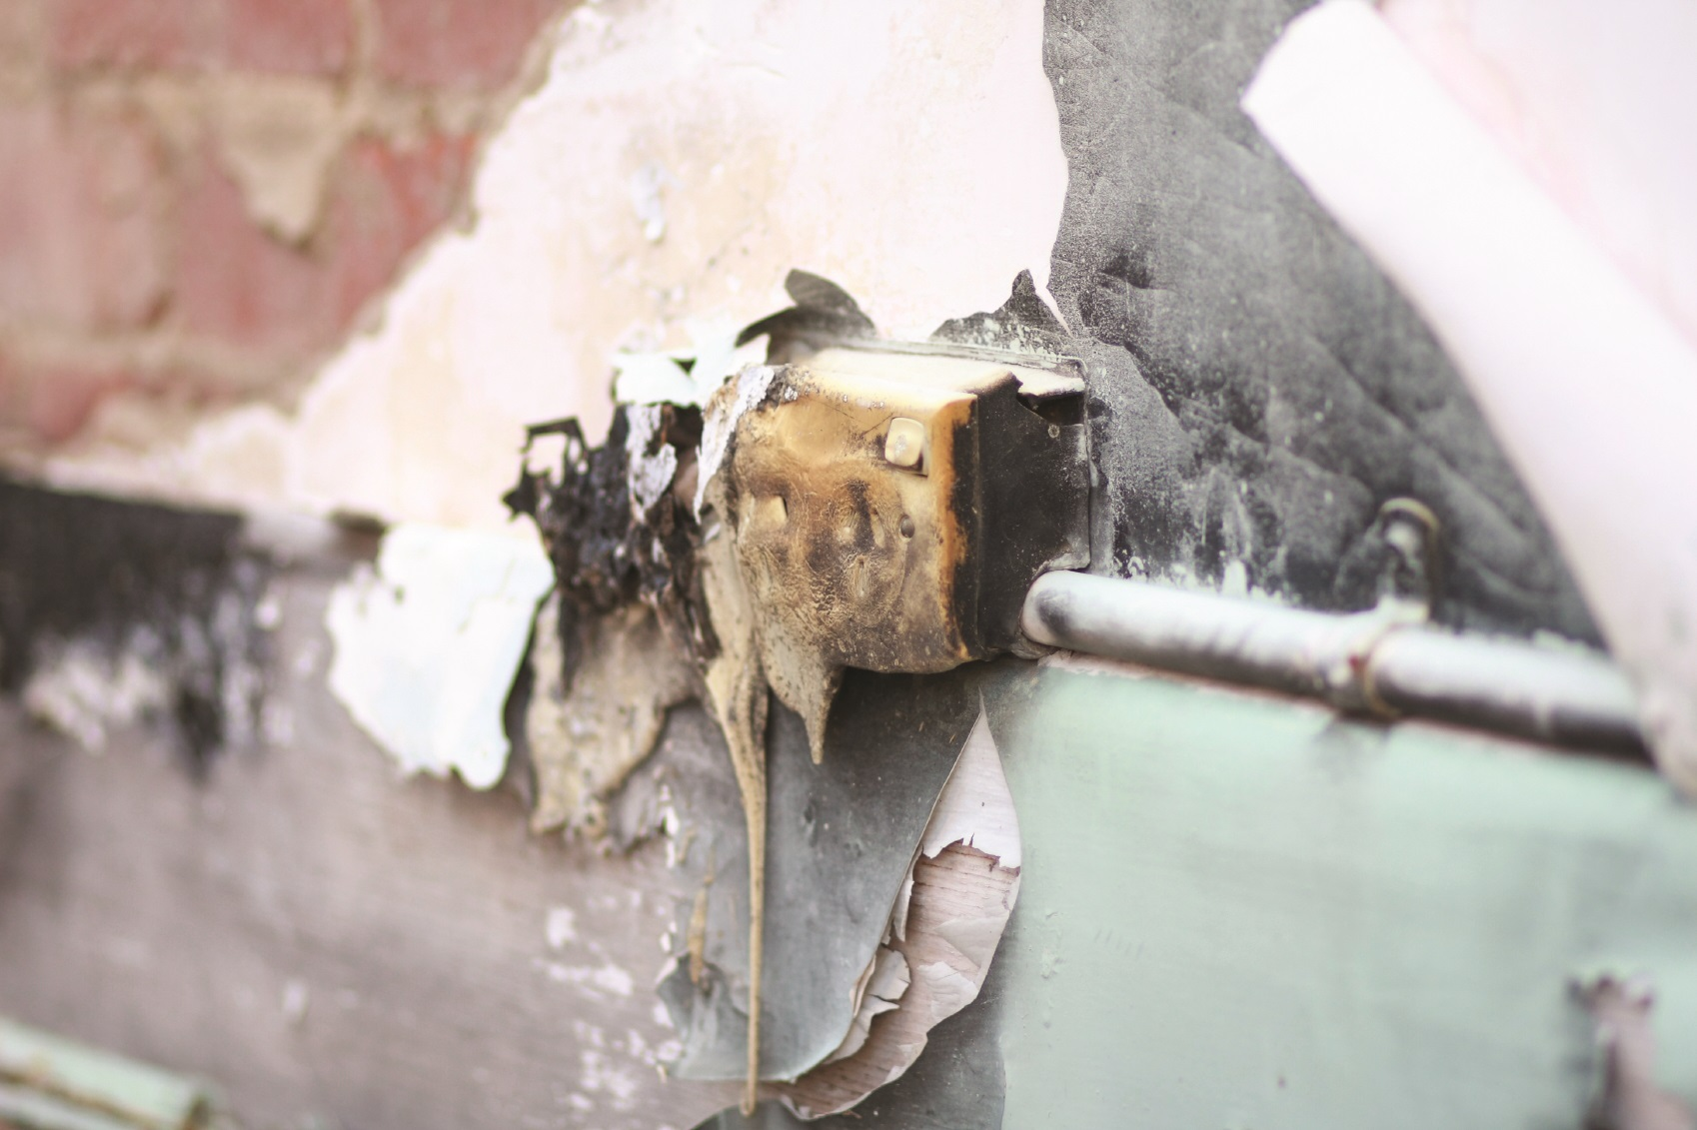
Electrical Safety Campaign

Slide 2
Statistics
Electricity is a cause of over 20,000 fires in UK homes every year.
89% of these fires are caused by electrical products 11% are caused by faults in electrical installations or misuse of electrical installations.
The top 5 products that cause the most fires are
1. Electrical cooking appliances such as cookers and microwaves
2. Laundry appliances
3. Electrical lighting
4. Portable heaters
5. Televisions
PRINTABLE USER GUIDANCE
Notes:
In total, these products cause almost 12,000 fires and 3,000 injuries every year.
In 2011/12 fires caused by electrical products caused
▪ 46 fire deaths
▪ 2.459 injuries
▪ Over £100 million in private property damage

Slide 3
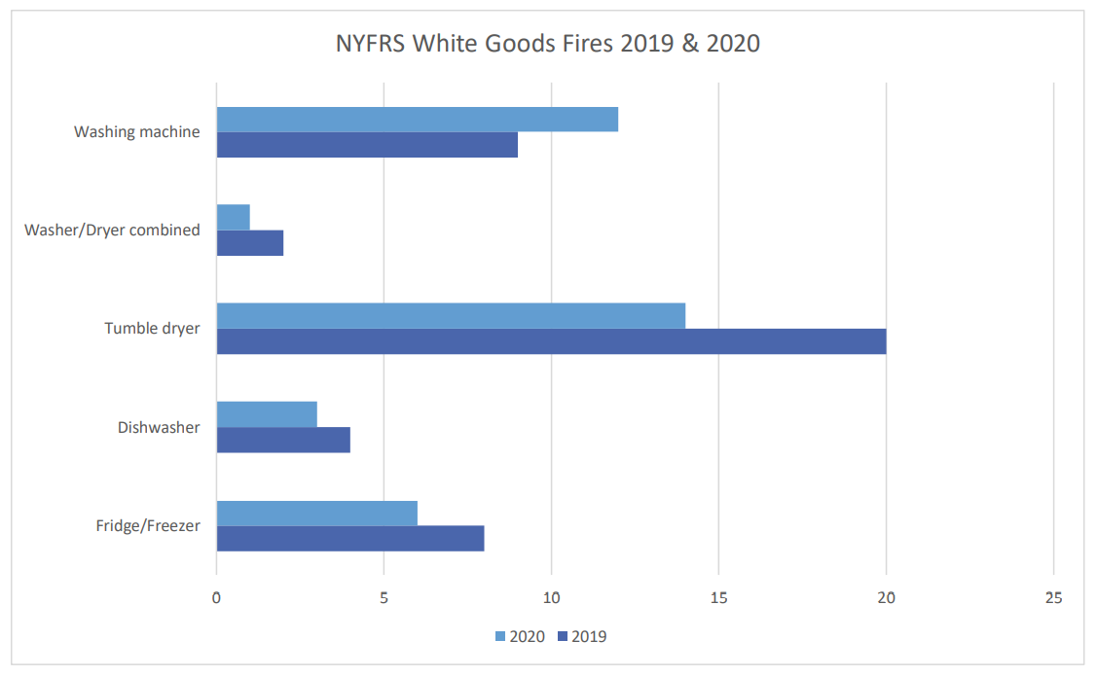
White Goods Fires

Slide 4
Register Your White Goods
Electrical distribution and appliances accounted for 37% of fires nationally in 2017/18.
Register your white goods on www.registermyappliance.org.uk so you can stay informed of repairs of recalls.
Don’t keep using appliances that begin to make a strange noise or smell of burning. Get them checked.
Never leave appliances such as tumble dryers and washing machines on overnight or when you go out.
Before buying second hand white goods check they haven’t been recalled and take care if an offer looks too good to be true especially on auction sites.
Always follow the instructions that came with your white goods.

Slide 5
Electrical Safety and Counterfeit Products
Smart technology is an obvious target for counterfeiters.
If you are buying online, buy from a trusted retailer.
If something goes wrong, you can return the product for repair or a refund.
Fake and substandard items can be almost impossible to spot.
Online shoppers are being misled by imagery taken from official product sites.
If a bargain seems too good to be true, it probably is.
Notes:
Smart technology will be a popular gift in the January sales, so it is an obvious target for counterfeiters.
If you are buying online, buy from a retailer that you know and trust, either direct from the manufacturer’s website or a trusted High Street name – that way if something goes wrong, you can return the product for repair or a refund.
Fake and substandard items can be almost impossible to spot.
Online shoppers are being misled by imagery taken from official product sites, fake official safety marks and believable pricing – items can even be priced just a few pounds below recommended retail value to avoid arousing suspicion.
Buying fake electrical products is particularly risky as they often contain faulty parts that can overheat and catch fire or deliver a fatal electric shock. While many items appear sophisticated on the outside, they lack essential safety components inside. If a bargain seems too good to be true, it probably is.

Slide 6
Electrical Safety Advice
Make sure you have the correct fuse in the plug.
Do not use appliances with damaged cables.
Check plugs for scorch marks and cable security.
Do not let pets chew cables.
Regularly check electric blankets for wear.
Never overload plug sockets.
Do not use ‘cube’ adaptors.
Register your white goods.
Notes:
Always make sure you use the right fuse to prevent overloading. It’s so important to use the right fuse for each electrical appliance to make sure the cable doesn’t overheat, and that the appliance is protected in the event of a fault.
Always stop using appliances if the cables are frayed or worn. Also check the cable is fastened securely to the plug and check sockets for scorch marks.
If you have pets ensure that they do not chew cables, especially if the cable is out of sight like behind a TV or cabinet
Always check electrical blankets regularly for wear. Avoid storing electric blankets tightly folded. Always store them either flat, rolled up or very loosely folded to prevent damaging the internal wiring and always unplug blankets before you get into bed.
Never overload plug sockets. If too many electrical items draw power from one socket it can overheat and catch fire. An extension lead or adaptor will have a limit to how many amps it can take so make sure you check you are not overloading it.
Never use cube style adaptors, these style of adaptors are usually older and don’t always have a fuse, also the weight of the plugs and leads attached to it can put strain on the pins, causing it to pull out the socket, creating a poor connection, overheating and fires.
Remember to register your white goods at www.registermyappliance.org.uk. This website provides up-to-date contact information for owners who have acquired specific models of electrical appliances within the last twelve years, so manufacturers can issue safety updates or repair notifications to the right homes. The website provides access to the registration pages of over 40 leading brands of domestic appliances, including most of the UK’s top selling brands of major white goods.

Slide 7
Laptops, Batteries & Charging
NEVER
Use a laptop that produces odd electrical smells and/or is hot to the touch.
Use incompatible computer batteries and chargers
Leave a phone charger plugged in and turned on when not in use.
Leave mobile phones charging on soft furnishings.
Leave e-cigarette batteries unattended whilst on charge.
Notes:
Never use a laptop that suddenly shuts down, produces odd electrical smells and/or is hot to the touch. It could be overheating, causing the laptop to completely fail or even catch fire.
Never use incompatible computer batteries and chargers with your laptop.
Never leave a phone charger plugged in and turned on when not in use.
Never leave mobile phones charging on soft furnishings or beds.
Never leave e-cigarette batteries unattended whilst on charge and don’t leave them charging for long periods of time.

Slide 8
Laptops, Batteries & Charging
ALWAYS
Ensure sockets are not overloaded.
Follow the battery guidelines.
Use the genuine charger for devices.
Use the charger supplied for e-cigarettes.
Look for the CE mark.
Avoid using laptops on soft surfaces.
REMEMBER, when devices are fully charged disconnect them.
Notes:
Always ensure sockets are not overloaded. You can check using the socket calculator on the Electrical Safety-First website www.electricalsafetyfirst.org.uk Always follow the battery usage, storage and charging guidelines in the user guide.
Always use the genuine charger that is designed for use with the product as substandard and counterfeit electrical chargers can be dangerous.
Always use the charger supplied for e-cigarettes as they need to be charged at the correct rate of charge. Ensure you follow the manufacturer’s instructions. Always look for the CE mark that indicates chargers comply with European Safety standards.
Avoid using laptops on soft surfaces such as sofas, beds, or carpets, which can restrict airflow.
Remember, when devices are fully charged disconnect them and turn the charger off.

